Slide 1


Asclepios AI
Data-Driven Treatment Optimization for Substance Use Disorder

Slide 2


Current Challenges in SUD Treatment
High Recidivism: Patients often return due to premature discharge.
No Standardization: Lack of systematic approach to personalize treatment length.
30%
Capacity Issues: Facilities struggle with effective capacity planning.
Readmission Rate
of patients return within one year, signaling inadequate treatment personalization.
Resource Mismatch: Disconnect between patient admissions and available resources.

Slide 3

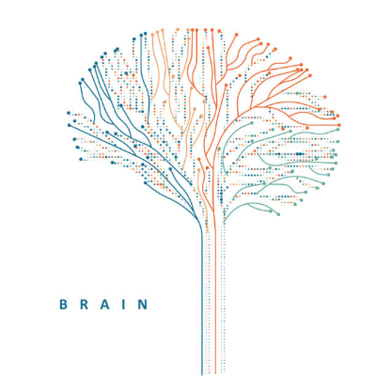
RESEARCH QUESTION
"How can we predict optimal treatment duration to minimize relapse risk?"
Our Approach
Using patient demographics, clinical history, and treatment factors to strictly personalize care.

Slide 4

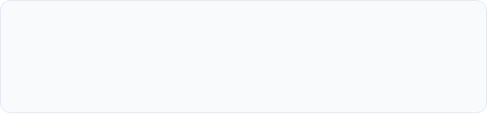



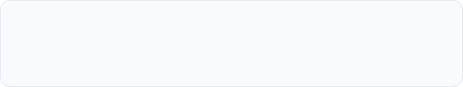
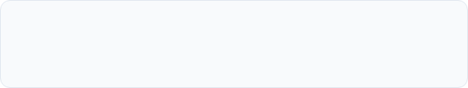

Asclepios AI: Smart Recommendation
Predict Duration
Reduce Readmissions
Calculates the optimal length of stay for every unique patient profile.
Minimizes relapse risk by ensuring treatment isn't cut short.
Optimize Resources
Personalize Care
Smart allocation of beds, staff, and clinical time.
Tailors recovery plans based on individual data points.
Personalized recommendations for recovery.

Slide 5

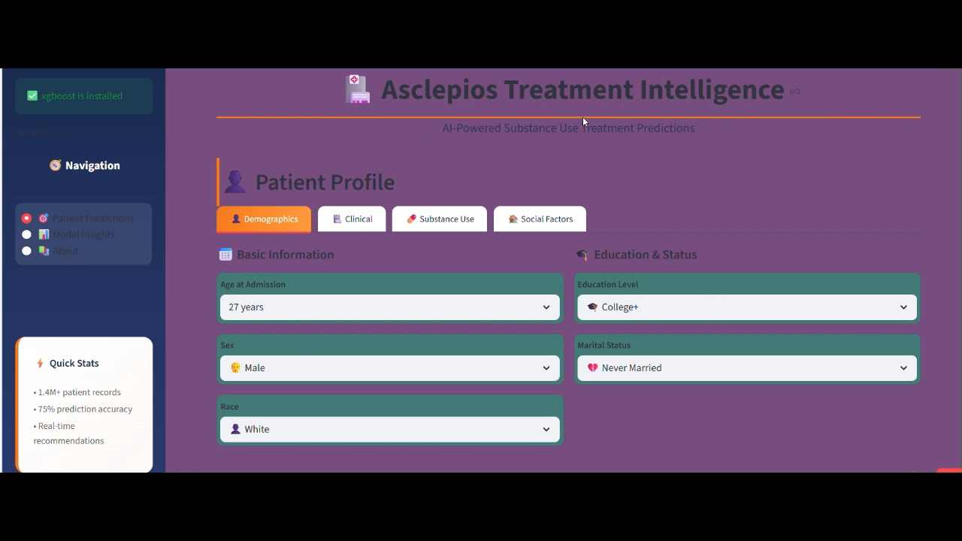
video

Slide 6
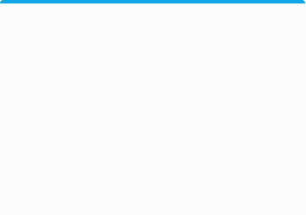
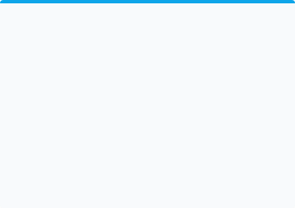
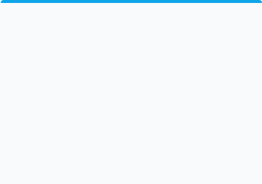

Our Models Deliver Actionable Insights
High-Risk Identification
Duration Prediction
Demand Forecasting
75%
±6 Days
±2 Beds
Accuracy in predicting relapse risk.
Accuracy of optimal length of stay.
Accuracy for capacity planning.
Impact
Data-driven personalization that improves patient outcomes while optimizing facility operations.

Slide 7


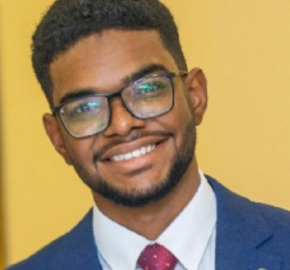


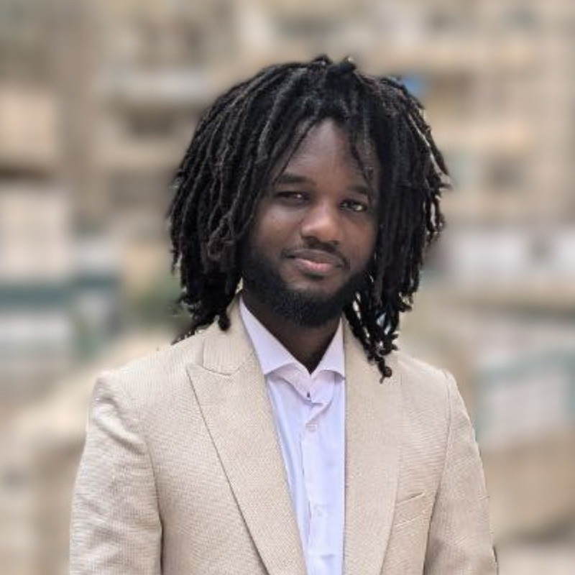



Asclepios AI Team
Asclepios AI is named after the Greek god of medicine and healing. His temples were the first hospitals. Our platform is the first AI-powered treatment optimizer. We bring ancient wisdom into the modern age of data-driven healthcare.
Rafaa Ali Abdalla
Caesar Ghazi
Mohamed Alwathiq Ali
Wuor Bhang

